Slide 1

MEMORY MODULE-II

Slide 2
Memory Organization:
Memory Hierarchy:
Memory hierarchy in a computer system:
Main Memory : Memory unit that communicates directly with the CPU (RAM)
Auxiliary Memory : Device that provide backup storage (Disk Drives)
Cache Memory : Special very-high-speed memory to increase the processing speed (Cache RAM)
Multiprogramming: Enable the CPU to process a number of independent program concurrently
Memory Management System: Supervise the flow of information between auxiliary memory and main memory
Memory Hierarchy is to obtain the highest possible access speed while minimizing the total cost of the memory system
5

Slide 3
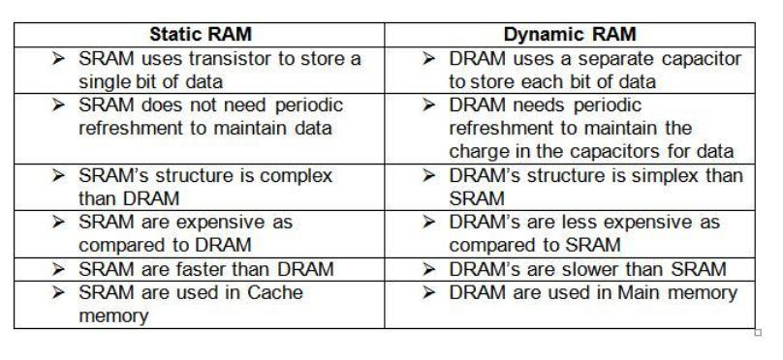
MAIN MEMORY
Random Access Memory (RAM):
Static RAM
Consists of Flip-flops to store binary information.
Static RAM is easier to use and having short Read/Write cycles
Used mostly in Cache memory.
Dynamic RAM
Stores binary information in the form of electric charge stored inside the capacitor.
The capacitors are provided by MOS transistors.
Refreshing circuit is required to refresh the memory.
Dynamic RAM offers reduced power consumption and large storage capacity.
It is used to construct main memory.
5

Slide 4
RAM Chips:
The common feature is a bidirectional data bus that allows the transfer of data either from memory to CPU during a read operation, or from CPU to memory during a write operation.
A bidirectional bus can be constructed with three-state buffers. A three-state buffer output can be placed in one of three possible states: a signal equivalent to logic 1, a signal equivalent to logic 0, or a high impedance state.
The high impedance state behaves like an open circuit, which means that the output does not carry a signal and has no logic significance. (Inhibit:unable to act)
The capacity of the memory is 128 words of eight bits (one byte) per word.
Chip select 1
CS1
Chip select 2
CS2
128 x 8
Read
RD
RAM
8-bit data bus
Write
WR
7-bit address
AD 7
CS1 CS2 RD WR
Memory function
State of data bus
0 0 x x
Inhibit
High-impedence
0 1 x x
Inhibit
High-impedence
1 0 0 0
Inhibit
High-impedence
1 0 0 1
Write
Input data to RAM
1 0 1 x
Read
Output data from RAM
1 1 x x
Inhibit
High-impedence
5

Slide 5
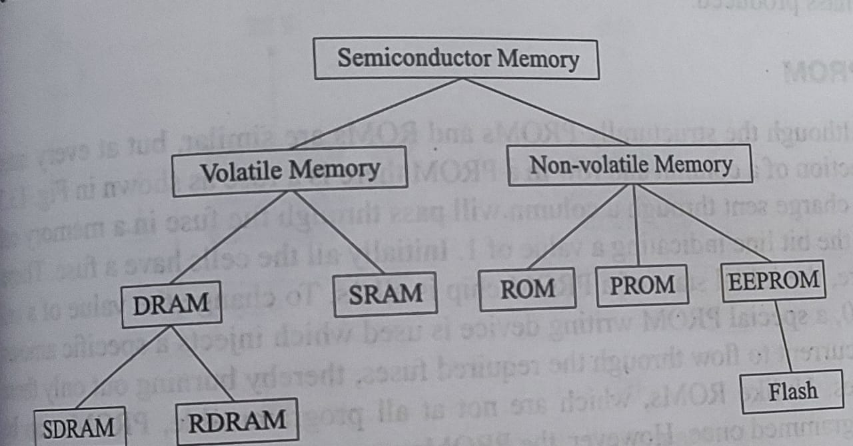
ROM Chips:
However, since a ROM can only read, the data bus can only be in an output mode.
For the same-size chip, it is possible to have more bits of ROM than of RAM, because the internal binary cells in ROM occupy less space than in RAM.
For this reason, the diagram specifies a 512-byte ROM, while the RAM has only 128 bytes.
The nine address lines in the ROM chip specify any one of the 512 bytes stored in it.
The two chip select inputs must be CS1 = 1 and CS2 = 0 for the unit to operate. Otherwise, the data bus is in a high-impedance state
Chip select 1
CS1
Chip select 2
CS2
512 x 8
8-bit data bus
ROM
9-bit address
AD 9
5

Slide 6
Memory Address Map:
The table, called a memory address map, is a pictorial representation of assigned address space for each chip in the system.
Assume that a computer system needs 512 bytes of RAM and 512 bytes of ROM.
The address bus lines are subdivided into groups of four bits each so that each group can be represented with a hexadecimal digit.
The first hexadecimal digit represents lines 13 to 16 and is always 0.
The next hexadecimal digit represents lines 9 to 12, but lines 11 and 12 are always 0. The range of hexadecimal addresses for each compo­nent is determined from the x's associated with it. These x's represent a binary number that can range from an all-0's to an all-1's value.
This configuration gives a memory capacity of 512 bytes of RAM and 512 bytes of ROM.
Hexadecimal
address
Address bus
Component
10 9 8 7 6 5 4 3 2 1
RAM 1
RAM 2
RAM 3
RAM 4
ROM
0000 - 007F
0080 - 00FF
0100 - 017F
0180 - 01FF
0200 - 03FF
0 0 0 x x x x x x x
0 0 1 x x x x x x x
0 1 0 x x x x x x x
0 1 1 x x x x x x x
1 x x x x x x x x x
5

Slide 7
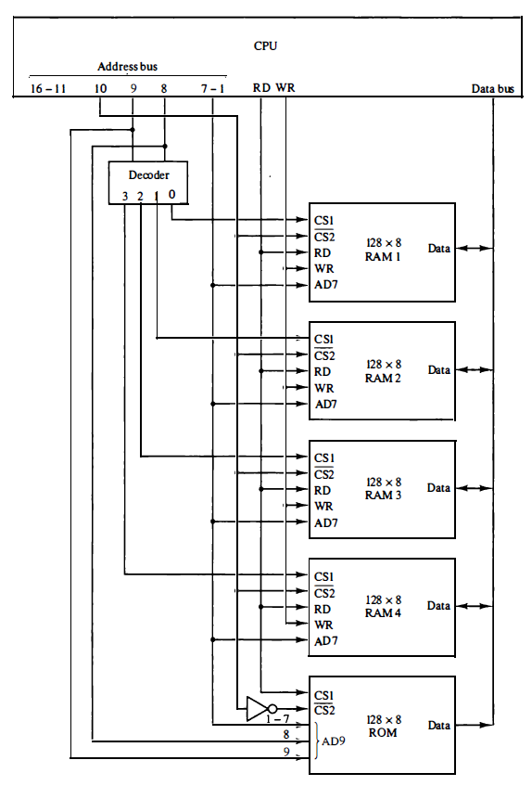
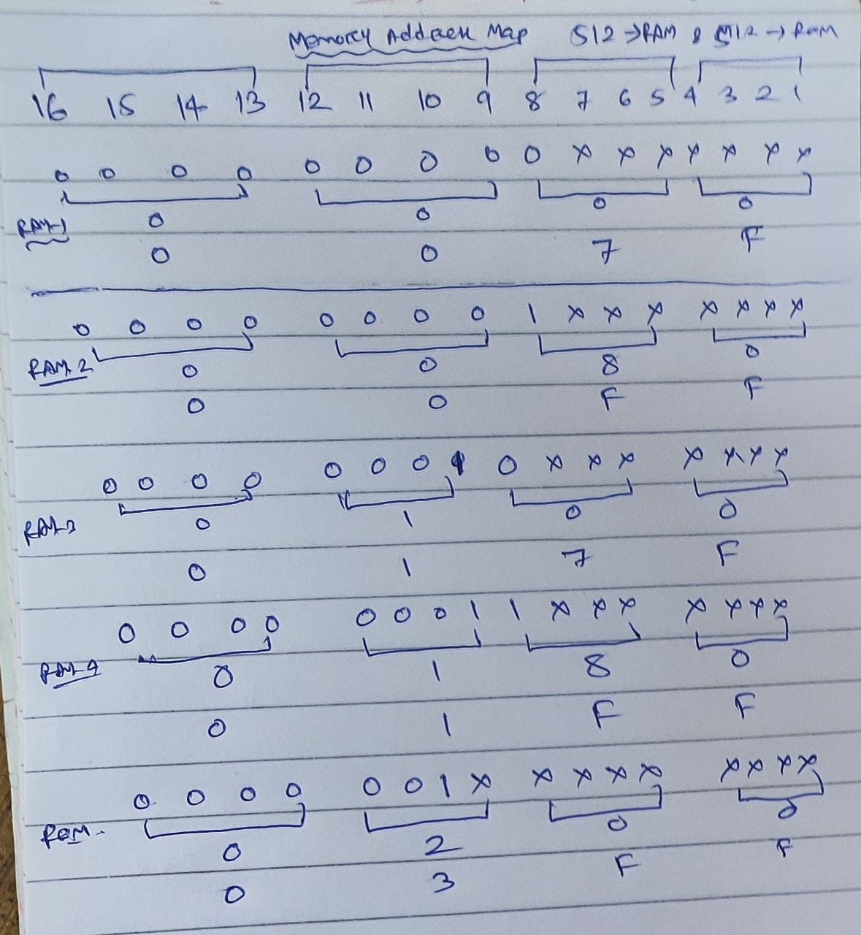
Memory Address Map:
5

Slide 8
Memory Address Map:
The particular RAM chip selected is determined from lines 8 and 9 in the address bus. This is done through a 2 x 4 decoder whose outputs go to the CS1 input in each RAM chip. Thus, when address lines 8 and 9 are equal to 00, the first RAM chip is selected. When 01, the second RAM chip is selected, and so on.
The RD and WR outputs from the microprocessor are applied to the inputs of each RAM chip.
The selection between RAM and ROM is achieved through bus line 10. The RAMs are selected when the bit in this line is 0, and the ROM when the bit is 1.
Memory Connection to CPU:
RAM and ROM chips are connected to a CPU through the data and address buses
The low-order lines in the address bus select the byte within the chips and other lines in the address bus select a particular chip through its chip select inputs.
5

Slide 9
Problems:
Q1. a) How many 128x8 RAM chips are needed to provide a memory capacity of 2048 bytes.
b) How many lines of the address bus must be used to access 2048 bytes of memory. How many of these lines will be common to all chips.
c) How many lines must be decoded for chip select? Specify the size of decoders.
Q2. Extend the memory system of CPU to 4096 bytes of RAM and 4096 bytes of ROM. List the memory-address map and indicate what size decoders are needed.
Q3. A computer employs RAM chips of 256x8 and ROM chips of 1024x8. The computer system needs 2K bytes of RAM, 4K bytes of ROM, and four interface units each with four registers. A memory-mapped I/O configuration used. The two highest-order bits of the address bus are assigned 00 for RAM, 01 for ROM, and 10 for interface registers.
a. How many RAM and ROM chips are needed.
b. Draw a memory-address map for the system.
c. Give the address range in hexadecimal for RAM, ROM and interface.
5

Slide 10
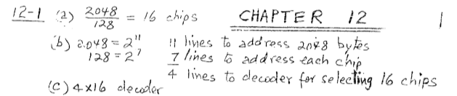
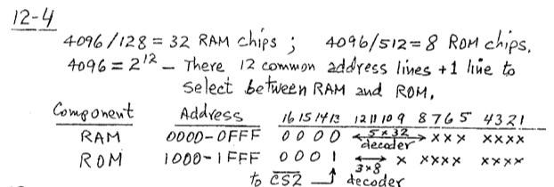
Solutions:
2⁴ = 16, 4 lines must be decoded for chip select.
Memory-address map:
5

Slide 11
Solutions:
3. RAM chips of 256x8 and ROM chips of 1024x8. The computer system needs 2K bytes of RAM, 4K bytes of ROM, and four interface units each with four registers.
The two highest-order bits of the address bus are assigned 00 for RAM, 01 for ROM, and 10 for interface registers.
5

Slide 12
Cache Memory:
Locality of Reference: The references to memory tend to be confined within a few localized areas in memory
Cache Memory: a fast small memory
Keeping the most frequently accessed instructions and data in the fast cache memory
Hit Ratio: The ratio of the number of hits divided by the total CPU references (hits + misses) to memory
hit : the CPU finds the word in the cache
miss : the word is not found in cache (CPU must read main memory)
Problem: A computer with cache access time of 100ns, a main memory access time of 1000 ns, a hit ratio of 0.9. Calculate average access time ?
Solution: H = 0.9, Tc = 100 ns Tm = 1000 ns
Average access time = HTc + (1-H) (Tc+Tm)
= 0.9x100 + (1-0.9)(100+1000) ns
= 90 + 110 = 200 ns
5

Slide 13
Types of Mapping of Cache Memory:
The basic characteristic of cache memory is its fast access time. Therefore, very little or no time must be wasted when searching for words in the cache.
Mapping: The transformation of data from main memory to cache memory is referred to as a mapping process. Three types of mapping procedures are of practical interest when considering the organization of cache memory.
1) Direct mapping (miss rate)
2) Associative mapping (Fully associate)
3) Set-associative mapping (K-way set-associate)
Direct mapping: Considering 128 words main memory is mapping with 16 words cache memory with 4 bit word in each section.
In main memory, sub parts are called block and in cache memory, they are called line. Here, which block is mapping to which line is decided by k mod n.
5

Slide 14
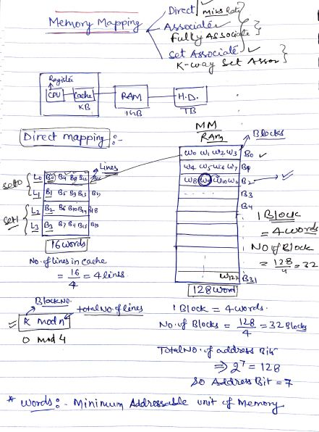
Direct mapping:
5

Slide 15
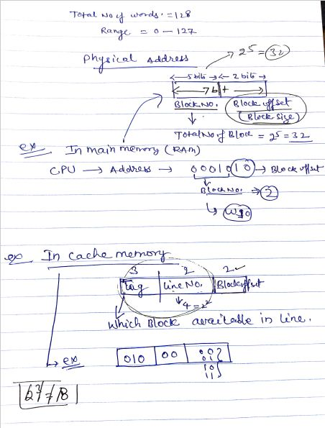
Direct mapping:
5

Slide 16
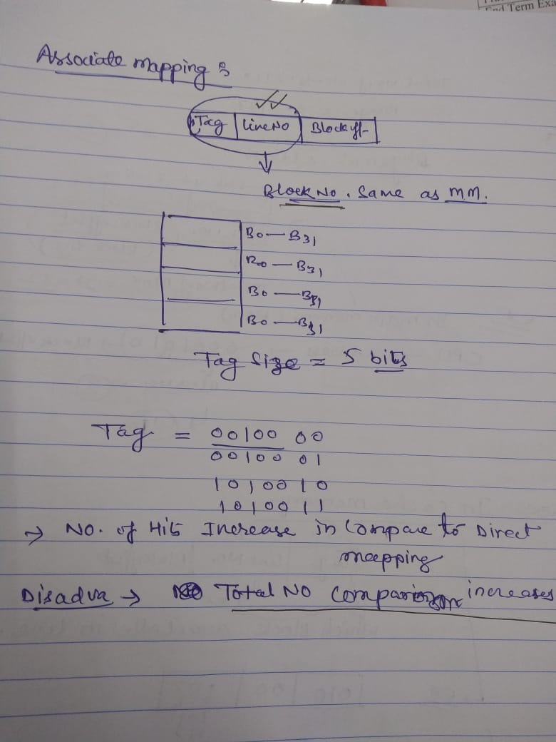
Associative mapping:
5

Slide 17
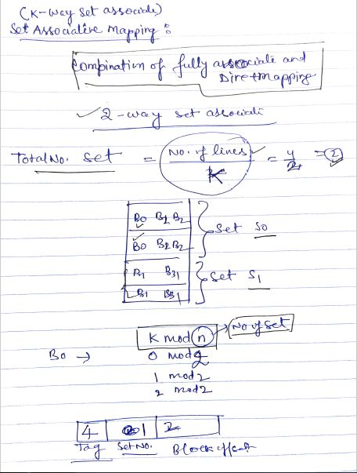
Set-Associative mapping:
5

Slide 18
Problems:
1. A two-way set associative cache memory uses blocks of four words. The cache can accommodate a total of 2048 words from main memory. The main memory size is 128Kx32. Formulate all pertinent information required to construct the cache memory. What is the size of cache memory.
2. The access time of a cache memory is 100ns and that of main memory is 1000ns. It is estimated that 80 percent of the memory requests are for read and the remaining 20 percent for write. The hit ratio for read access only is 0.9. A write-through procedure is used. What is the average access time of the system considering only memory read cycles. What is the average access time of the system for both read and write requests. What is the hit ratio considering the read requests also.
3. A computer has a memory unit of 64Kx16 and a cache memory of 1K words. The cache uses direct mapping with a block size of four words. How many bits are there in the tag, index, block, and words fields of the address format. How many bits are there in each word of cache, and how are they divided into functions? Include a valid bit. How many blocks can the cache accommodate?
5

Slide 19
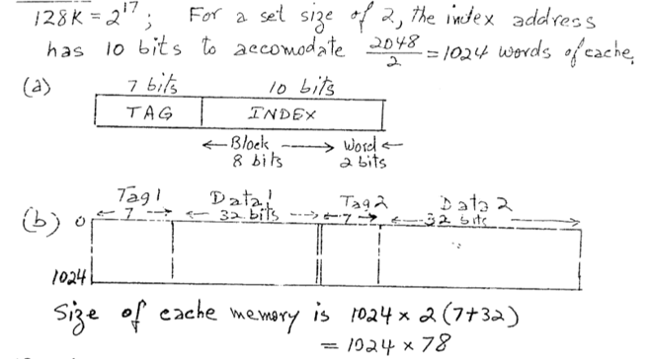
Solutions:
Main memory address= 128k = 2⁷ X 2¹⁰ = 2¹⁷ =17 bits
Cache memory address: 2048/2 = 1024 = 2¹⁰ = 10 bits
Tag = 17-10 = 7
Index = 10
Block = 1024/4 = 256 = 2⁸ = 8 bits
(4 words in each block and total 2048/2=1024 words)
The size of cache memory = horizontal X vertical = 1024 x 2 (7+32) = 1024 x 78
Given data size is 32.
5

Slide 20
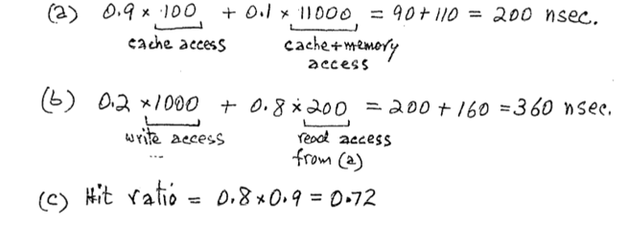
Solutions:
2. The access time of a cache memory is 100 ns and that of main memory is 1000 ns. It is estimated that 80 percent of the memory requests are for read and the remaining 20 percent for write. The hit ratio for read access only is 0.9.
Average access time = HTc + (1-H) (Tc+Tm)
5

Slide 21
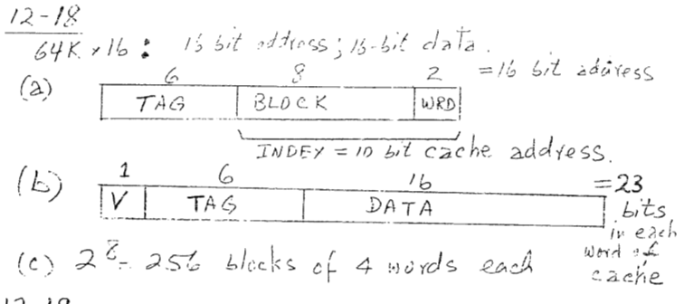
Solutions:
3. A computer has a memory unit of 64Kx16 and a cache memory of 1K words. The cache uses direct mapping with a block size of four words.
Memory = 64K = 2⁶ x2¹⁰ = 2¹⁶ = 16 bits address
Cache = 1K = 2¹⁰ = 10 bits
TAG = 16-10 = 6
Index = 10
Block = 1024/4 = 256 = 2⁸ = 8 bits
5

Slide 22
PAGE REPLACEMENT:
Replacement Algorithm : cache miss or full
1) LRU (Least Recently Used)
2) Random Replacement
3) FIFO (First-In First-Out)
Writing to Cache:
1) Write-through: To update main memory with every memory write operation with catch memory updated in parallel.
2) Write-back: Only the cache location is updated during a write operation.
Cache Initialization
Cache is initialized:
1) When power is applied to the computer.
2) When main memory is loaded with a complete set of programs from auxiliary memory.
3) Cache is initialized by clearing all the valid bits to 0.
Valid bit:
Indicate whether or not the word contains valid data
5

Slide 23
Virtual Memory:
In a memory hierarchy system, programs and data are first stored in auxiliary memory. Portions of a program or data are brought into main memory as they are needed by the CPU.
Virtual memory is a concept used in some large computer systems that permit the user to construct programs as though a large memory space were available, equal to the totality of auxiliary memory.
Each address that is referenced by the CPU goes through an address mapping from the so-called virtual address to a physical address in main memory.
Virtual memory is used to give programmers the illusion that they have a very large memory at their disposal, even though the computer actually has a relatively small main memory.
An address used by a programmer will be called a virtual address, and the set of such addresses the address space. An address in main memory is called a location or physical address. The set of such locations is called the memory space.
address space
memory space
virtual address
(logical address)
Mapping
physical address
address generated by programs actual main memory address
5

Slide 24
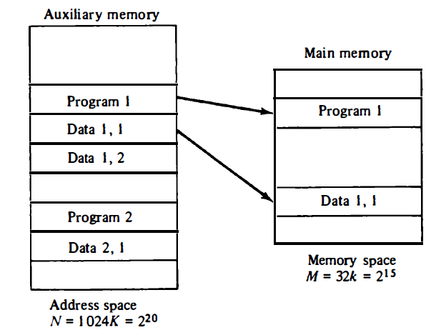
Virtual Memory:
Address Space (Logical) and Memory Space (Physical):
Consider a computer with a main-memory capacity of 32K words (K=1024). Fifteen bits are needed to specify a physical address in memory since 32K=2¹⁵. Suppose that the computer has available auxiliary memory for storing 2²⁰=1024K words.
Thus auxiliary memory has a capacity for storing information equivalent to the capacity of 32 main memories. Denoting the address space by N and the memory space by M, we then have for this example N = 1024K and M = 32K.
5

Slide 25
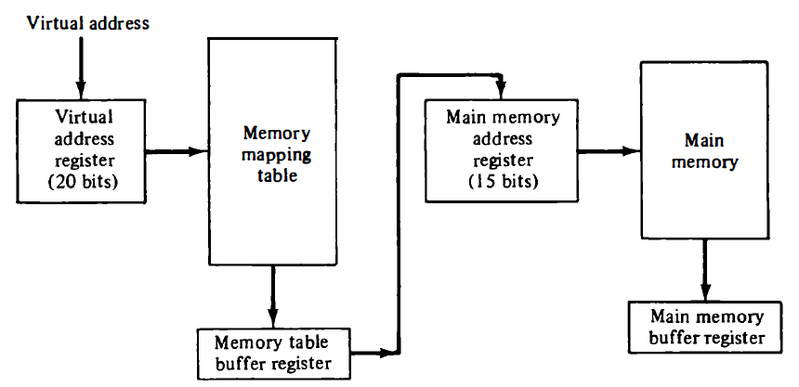
Virtual Memory:
Address Mapping:
Memory Mapping Table for Virtual Address -> Physical Address
5

Slide 26
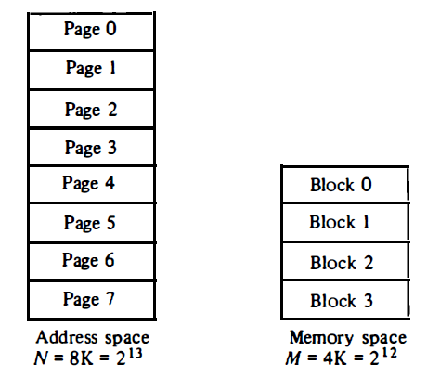
Address Mapping Using Pages:
Address Space and Memory Space are each divided into fixed size group of words called blocks or pages.
Consider a computer with an address space of 8K and a memory space of 4K. If we split each into groups of 1K words we obtain eight pages and four blocks.
Address space and memory space split into groups of lK words:
5

Slide 27
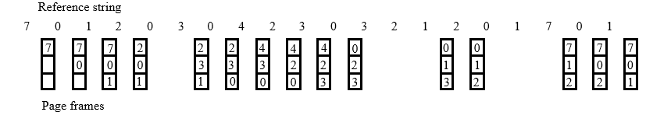
PAGE REPLACEMENT ALGORITHMS:
Two of the most common replacement algorithms used are the first-in first-out (FIFO) and the least recently used (LRU).
The FIFO algorithm selects for replacement the page that has been in memory the longest time.
The LRU policy is more difficult to implement but has been more attractive on the assumption that the least recently used page is a better candidate for removal than the least recently loaded page as in FIFO.
FIFO:
5

Slide 28
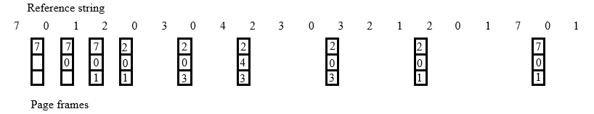
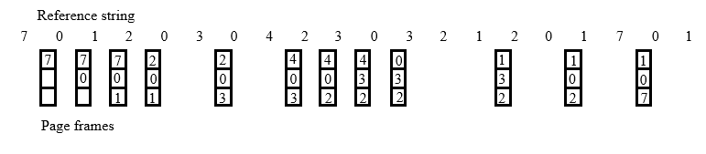
PAGE REPLACEMENT ALGORITHMS:
Optimal Replacement (OPT): Lowest page fault rate of all algorithms.
Replace that page which will not be used for the longest period of time.
LRU: OPT is difficult to implement since it requires future knowledge.
In LRU replace that page which has not been used for the longest period of time.
5

Slide 29
Problems:
A virtual memory system has an address space of 8K words, a memory space of 4K words and page & block sizes are of 1K words. The following page is referenced in memory: 4 2 0 1 2 6 1 4 0 1 0 2 3 5 7. Determine the four pages that are resident in main memory after each page reference change if page replacement algorithm is : FIFO, LRU, Optimal.
Solution:
5

Slide 30
Problems:
2. An address space is specified by 24 bits and the corresponding memory space by 16 bits. How many words are there in the address space. How many words are there in the memory space. If a page consists of 2K words, how many pages and blocks are there in the system?
Solution:
5

Slide 31
THANK YOU

